Slide 1
KIET Group of Institutions, Ghaziabad
Exploring the Potential of Augmented Reality Technology for Comprehensive and In-Depth Human Anatomy Learning
Group ID: PCSE25-66
Student Name: Shahnawaz Semester : 8 Department: Computer Science and Engineering
Name of Project Guide : Prof. Ankur Bhardwaj
Date of Presentation : 24/05/2025
Alignment with UN Sustainable Development Goals (SDGs)
SDG 4: Ensure inclusive and equitable quality education and promote lifelong learning opportunities for all
SDG 3: Ensure healthy lives and promote well-being for all at all ages
SDG 17: Strengthen the means of implementation and revitalize the Global Partnership for Sustainable Developmentengthen the means of implementation and revitalize the Global Partnership for Sustainable Development
1

Slide 2
KIET Group of Institutions, Ghaziabad
Problem Statement
Traditional methods of learning human anatomy through static images and illustrations lack interactivity and do not provide a comprehensive, immersive understanding of anatomical structures. This results in decreased engagement, restricted spatial comprehension, and difficulty visualizing intricate anatomical relationships. In addition, the limited availability of anatomical models and the need for specialized equipment or facilities restrict learning to specific locations and impede opportunities for self-directed study.
2

Slide 3
KIET Group of Institutions, Ghaziabad
Solution
The app addresses the need for a more accessible and interactive learning tool that uses augmented reality technology to improve the visualisation of 3D anatomical models. By providing real-time visualisation and interactive features, the app aims to enhance human anatomy learning's engagement, spatial comprehension, and accessibility.
3

Slide 4
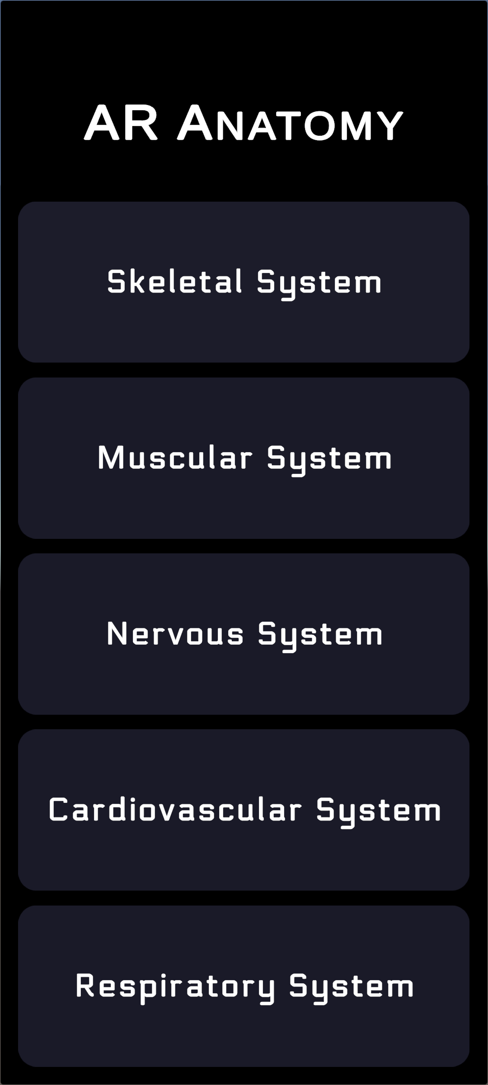
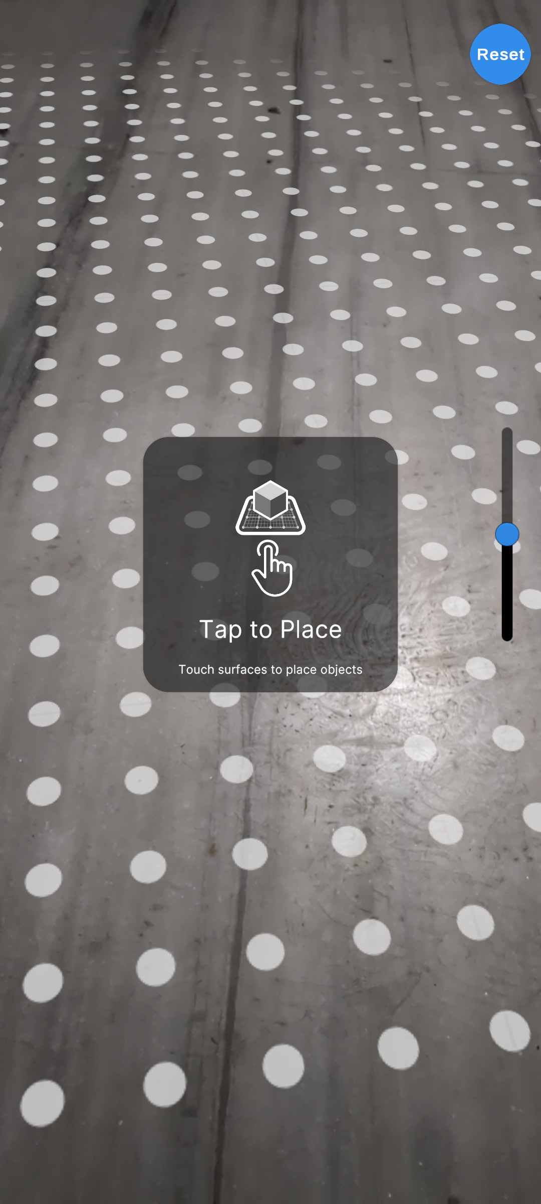
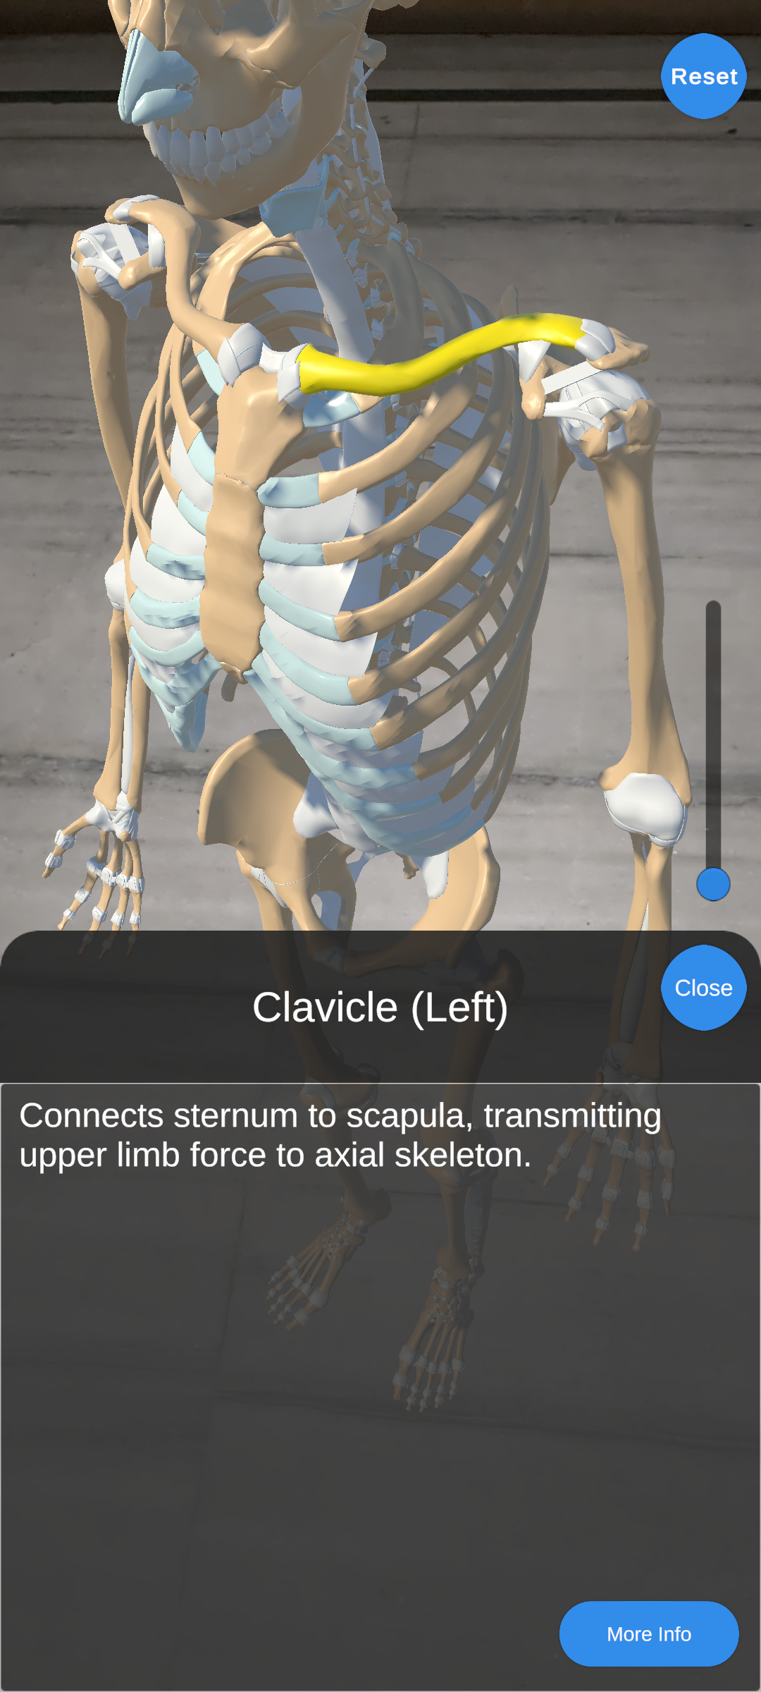
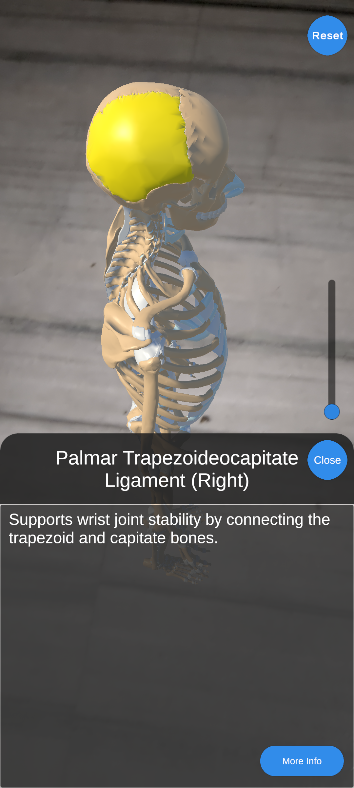
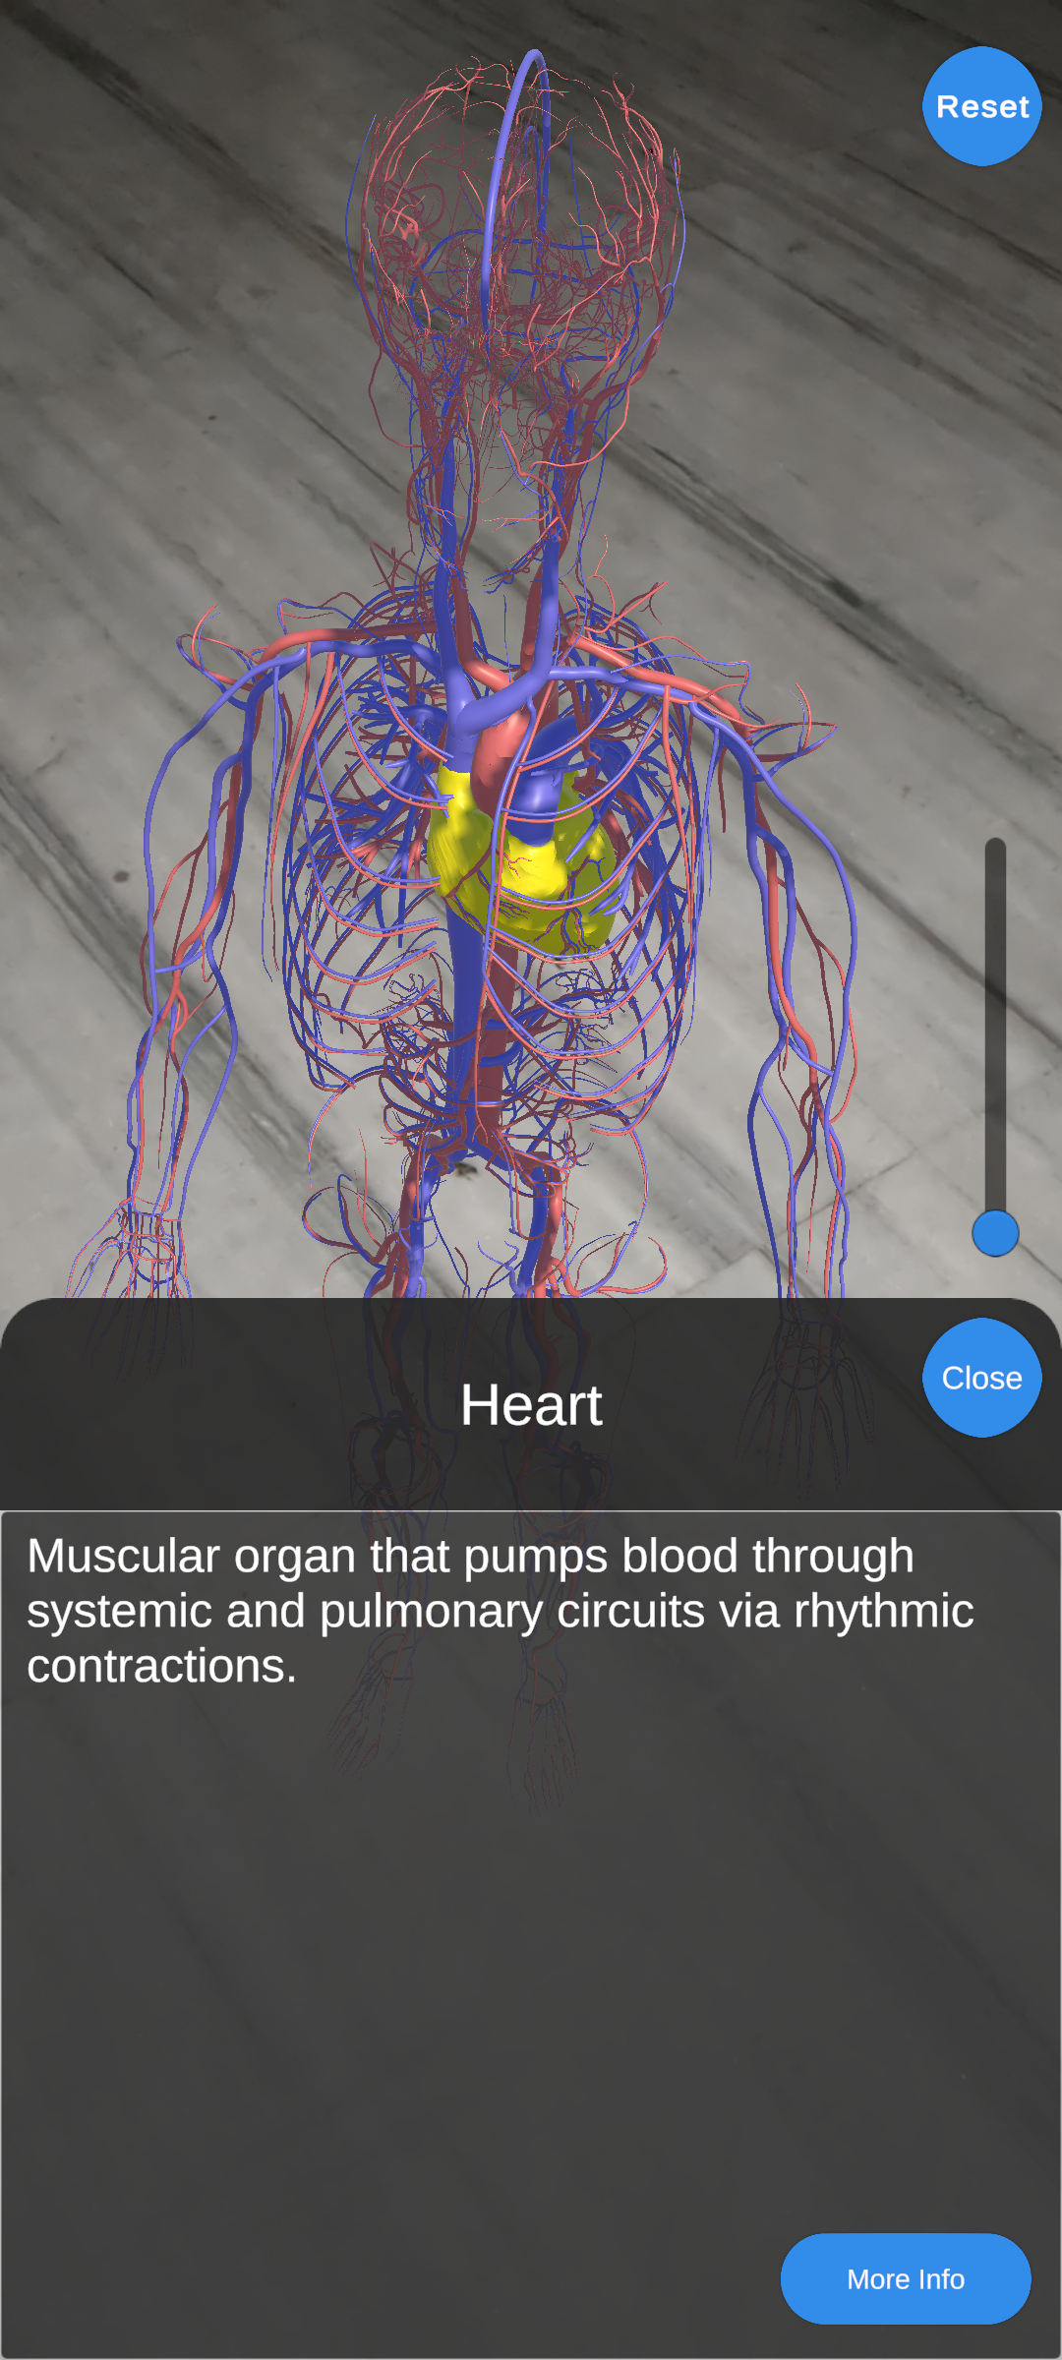
KIET Group of Institutions, Ghaziabad
4

Slide 5
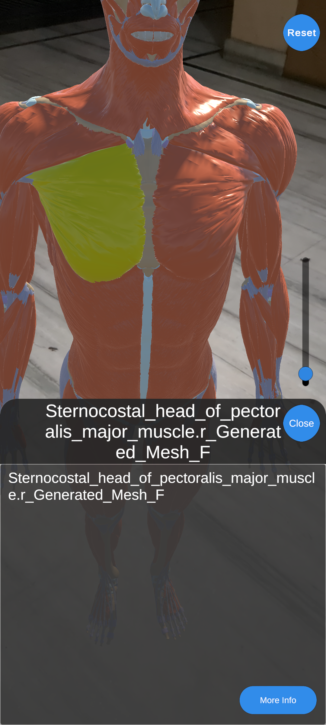
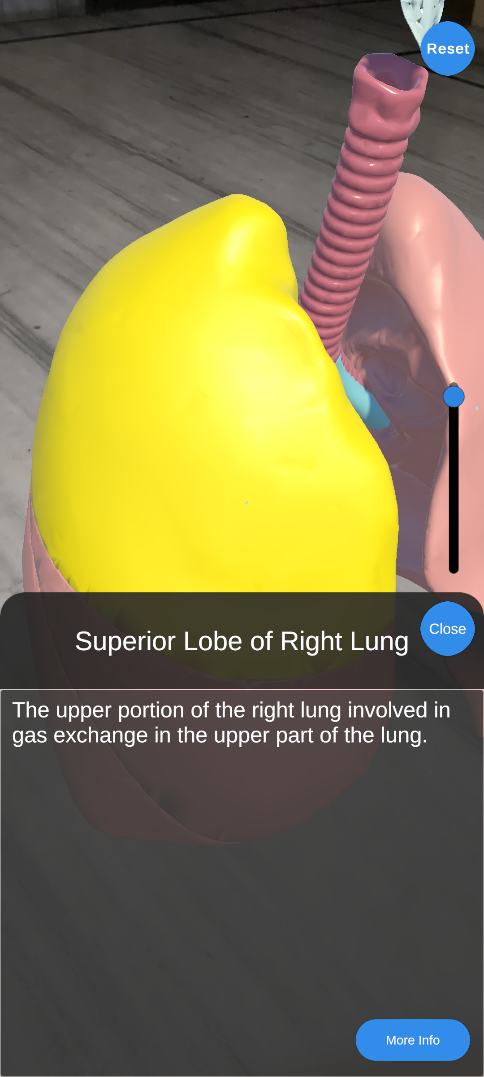
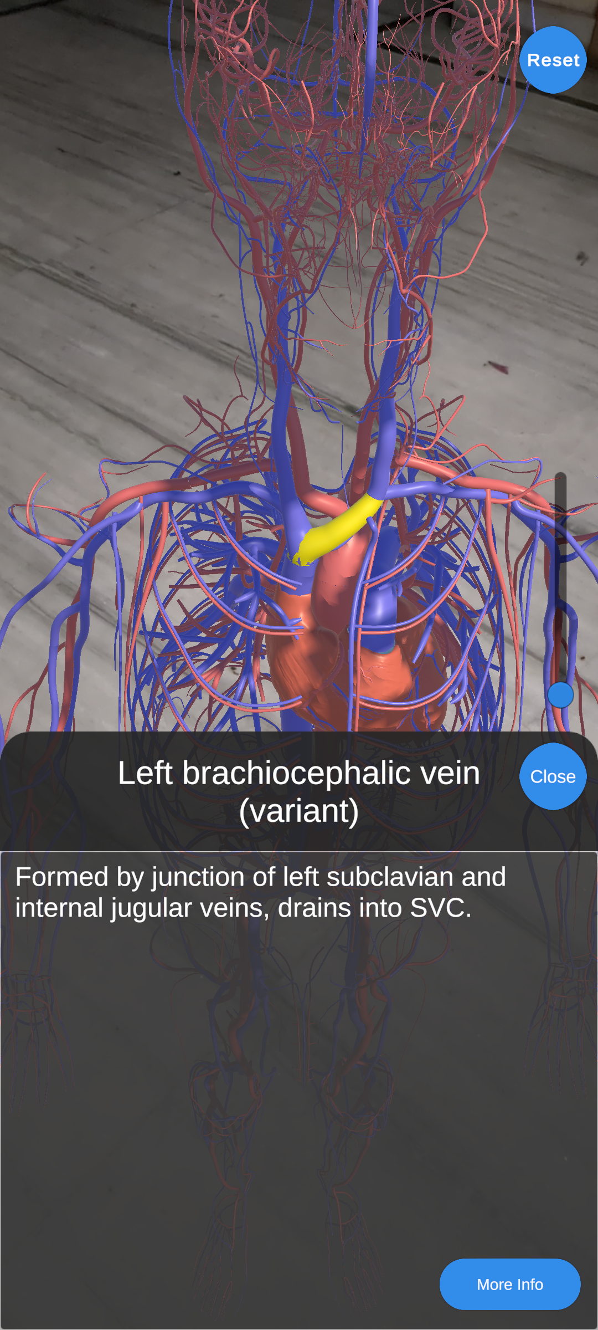
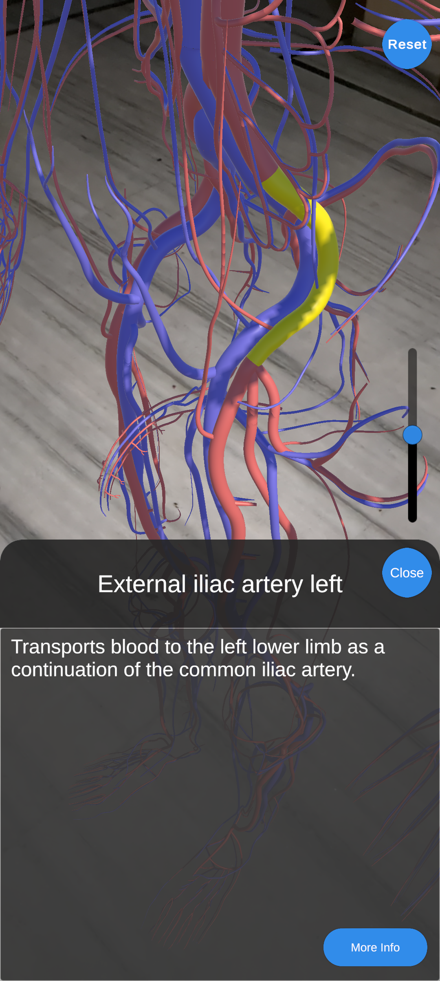
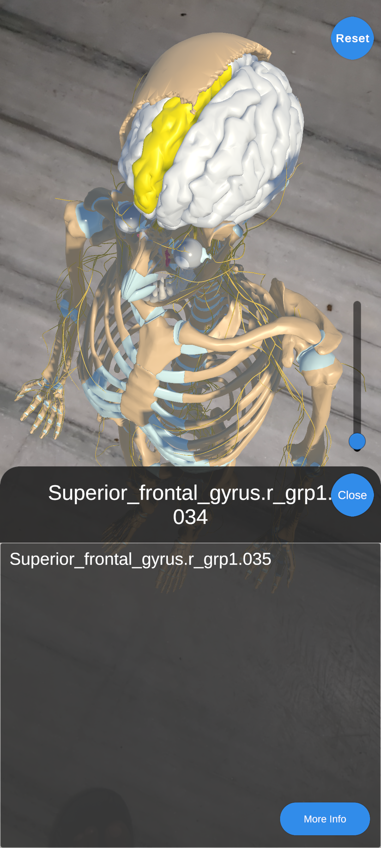
KIET Group of Institutions, Ghaziabad
5

Slide 6
KIET Group of Institutions, Ghaziabad
Project Objectives
Our 4 Major Objectives of our project are:-
Immersive and Interactive Learning: The primary objective of your app is to provide an immersive and interactive learning experience. Users should be able to explore the human anatomy in a captivating and engaging manner through high-quality 3D models, intuitive controls, and interactive features such as gestures and animations.
Personalized and Gamified Education: Another objective is to offer personalized and gamified educational content. Users should have the ability to customize their learning paths, track their progress, and engage in quizzes, challenges, or mini-games to make the learning process enjoyable, rewarding, and conducive to long-term retention.
Comprehensive Anatomy Knowledge: Your app should aim to provide a comprehensive understanding of human anatomy. This objective involves including detailed labels, descriptions, and information about various anatomical structures, functions, and relationships. Users should be able to access in-depth information on specific body parts and systems, helping them gain a thorough knowledge of human anatomy.
Enhanced Visualization and Exploration: The objective here is to provide users with advanced visualization capabilities and an immersive exploration experience of the human anatomy. This can include features like virtual dissection, cross-section views, X-ray vision, or dynamic animations that allow users to delve deeper into the intricacies of the human body.
Notes:
Immersive and Interactive Learning, Personalized and Gamified Education, Comprehensive Anatomy Knowledge, Enhanced Visualization and Exploration

Slide 7
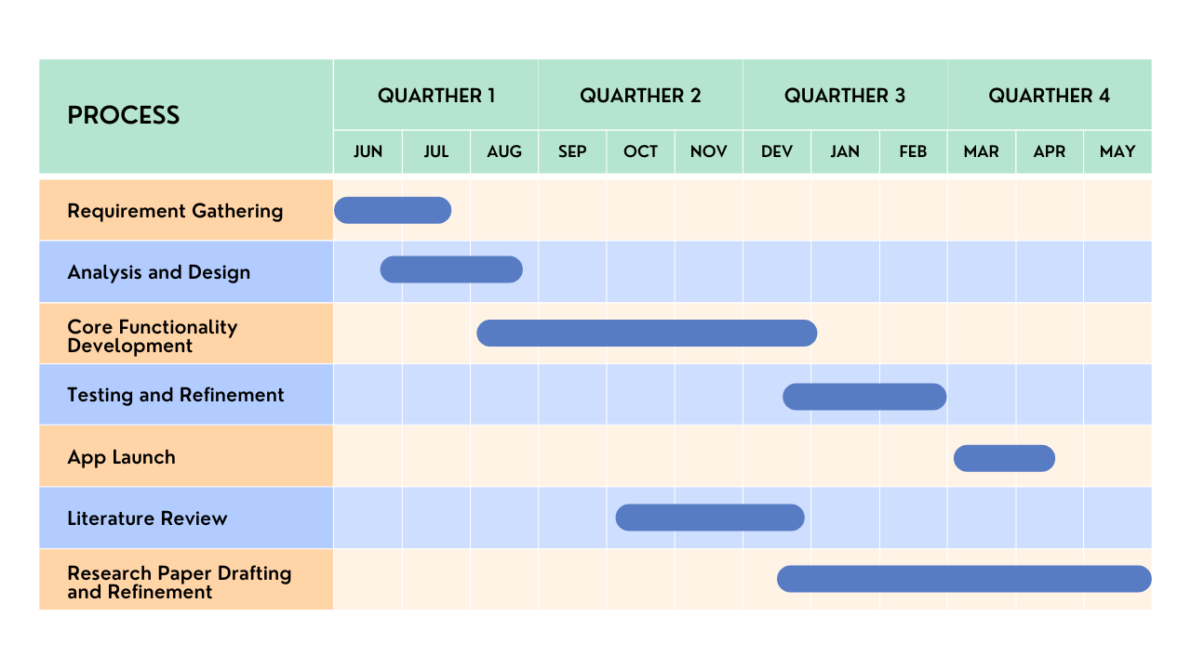
KIET Group of Institutions, Ghaziabad
Project Timeline
7

Slide 8
KIET Group of Institutions, Ghaziabad
Literature Review
Introduction:
Augmented reality (AR) has emerged as a promising technology in the field of education, particularly in the domain of human anatomy. This literature review aims to explore the existing research and developments in augmented reality applications for human anatomy education, focusing on the benefits, challenges, and effectiveness of such apps.
Benefits of Augmented Reality in Anatomy Education:
Numerous studies have highlighted the benefits of incorporating augmented reality in anatomy education. AR apps provide an immersive and interactive learning experience, allowing students to visualize and manipulate 3D models of anatomical structures. This hands-on approach enhances spatial understanding and promotes active engagement, resulting in improved retention and comprehension of complex anatomical concepts.
Effectiveness of Augmented Reality Apps:
Research studies have demonstrated the effectiveness of augmented reality apps in human anatomy education. They have shown that students using AR apps outperform those using traditional methods in terms of knowledge retention, spatial understanding, and anatomical accuracy. AR apps also foster higher levels of motivation and interest among students, making the learning process more enjoyable and engaging.
8

Slide 9
KIET Group of Institutions, Ghaziabad
Challenges and Limitations:
While augmented reality offers significant advantages, several challenges and limitations should be considered. Technical limitations, such as device compatibility, tracking accuracy, and rendering quality, can affect the overall user experience. Additionally, the availability and quality of content within AR apps, including anatomical models and educational resources, can vary widely. Ensuring accuracy, completeness, and relevance of the content is crucial for the effectiveness of the app.
Current Trends and Future Directions:
The current landscape of augmented reality anatomy apps showcases a variety of features and functionalities. These include interactive 3D models, virtual dissection, cross-section views, gamification elements, and social sharing. Moreover, advancements in wearable devices, such as AR glasses and haptic feedback systems, present exciting opportunities for further enhancing the learning experience.
Conclusion:
Augmented reality applications for human anatomy education have demonstrated considerable potential in improving learning outcomes and student engagement. As technology continues to evolve, addressing the challenges related to content quality, technical limitations, and accessibility will be essential for the continued success of AR apps in this domain. Further research is needed to explore the long-term effects, efficacy in different educational settings, and optimal integration of augmented reality in anatomy curricula.
9

Slide 10
KIET Group of Institutions, Ghaziabad
References
[1] K. A. Bölek, G. De Jong, and D. Henssen, “The effectiveness of the use of augmented reality in anatomy education: A systematic review and meta-analysis,” Nature News, https://www.nature.com/articles/s41598-021-94721-4 (accessed Oct. 20, 2023).
[2] L. Cercenelli et al., “Aeducaar, anatomical education in augmented reality: A pilot experience of an innovative educational tool combining AR technology and 3D printing,” MDPI, https://www.mdpi.com/1660-4601/19/3/1024 (accessed Oct. 20, 2023).
[3] D. Korre and A. Sherlock, “Augmented reality in higher education: A case study in medical education,” arXiv.org, https://arxiv.org/abs/2308.16248 (accessed Oct. 20, 2023).
[4] A. Nugroho, A. E. Permanasari and B. S. Hantono, "Augmented Reality Implementation for Human Anatomy Learning in Medical Education: A Review," 2022 8th International Conference on Education and Technology (ICET), Malang, Indonesia, 2022, pp. 256-260, doi: 10.1109/ICET56879.2022.9990829.

Slide 11
KIET Group of Institutions, Ghaziabad
Thank You

